Slide 1
Human Resource Management
Topic : HRM
Name : P. Siva Krishna
Prepared by Roll Number : 1291-18-672-291

Slide 2
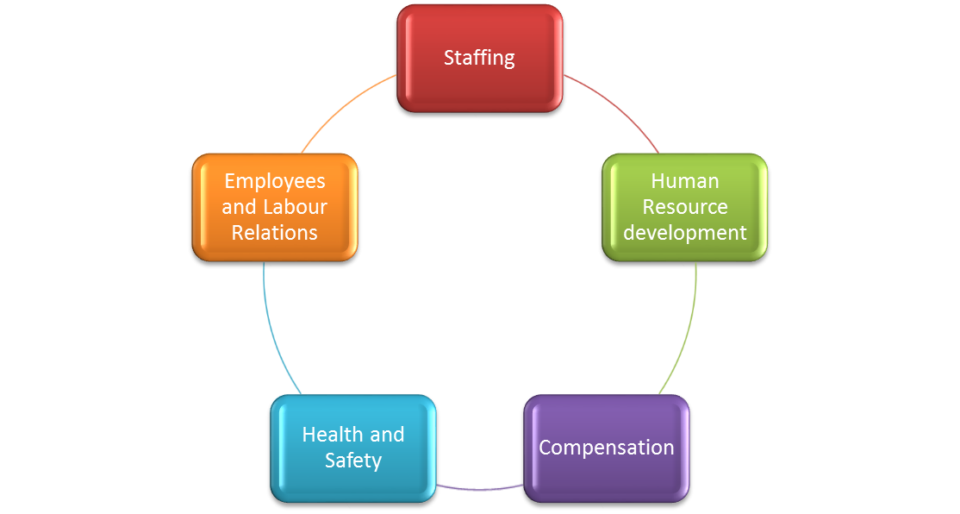
Functions of HRM
  Human Resource management is a combination of five different functions and a HR manager can increase the effectiveness of its workforce by strategically performing these functions human resource management includes

Slide 3
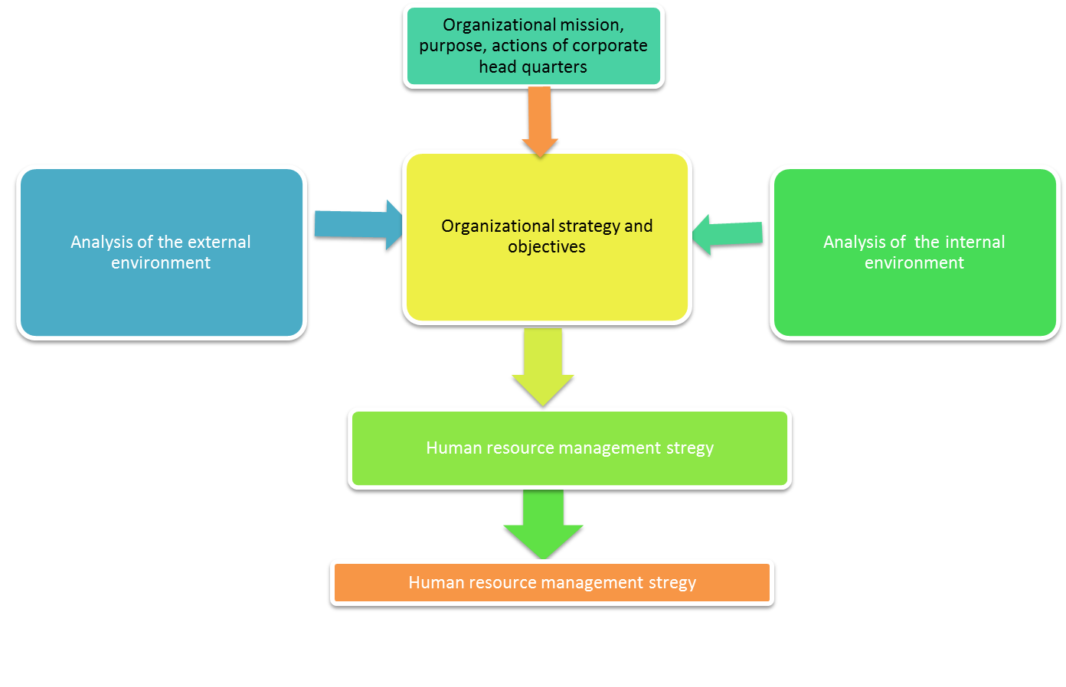
Purpose of Human resource management Policies and Practices

Slide 4
Contribution of SHRM to Achievement of an organizational goals
Strategic Human resource management includes the implementation of right skills at right place on right time in order to achieve organizations long term goals
It requires taking optimum utilization of workforce by assigning them duties according to their skillsets.
In current competitive market it is not possible for any organization to achieve their objectives with out contribution of their work force

Slide 5
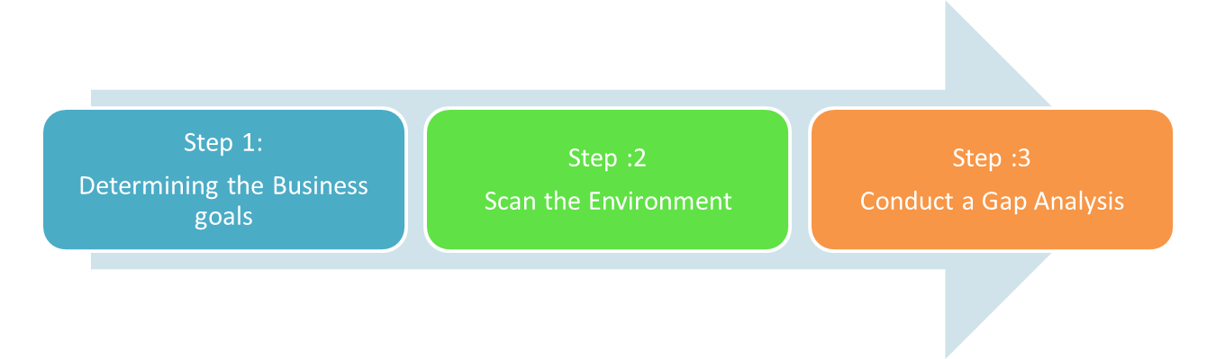
HRM Planning
Step:4
Set HR Priorities to help
Achieve Departmental goals
STRATEGIES
Developing a talent pool
Work environment Improvements
Competency /skills
Development
Employee Engagement
Work place well being
Recruitment / staffing
Retention
Measure ,Monitor and Report on Progress

Slide 6
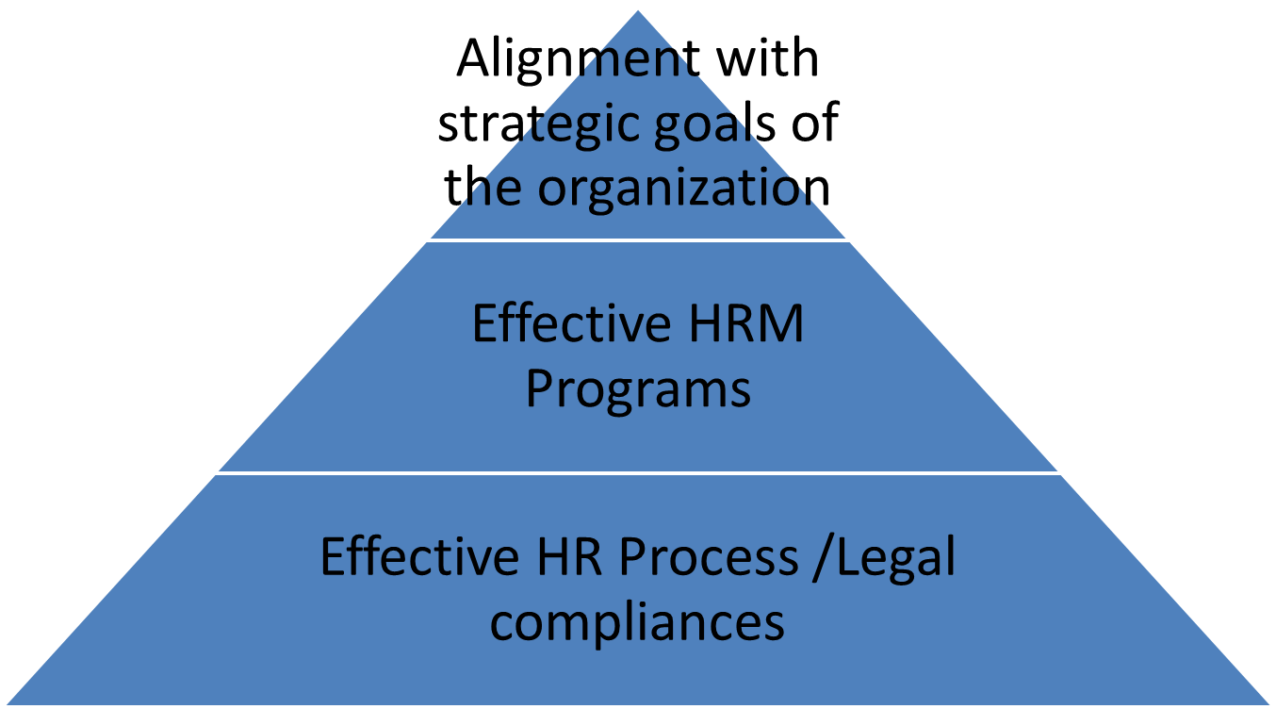
Alignment with Mission

Slide 7
Impact of regulatory requirement on Human resource policies
Government has been at front position in cheering employees Participation and their role in an organization
Government introduce various rule and schemes in order to maintain employees interest into the organization regarding their rights ,health and safety and other applicable legislation

Slide 8
Impact of organization culture on management of human resource
Organizations can be defined as societies or as nations or as individuals due to extensivly differing cultures that reflects the beliefs, ideas and values
The leadership styles of top managers play a key role in identifying the organization culture
Good cultures within the organization motivate people as well as provide a good working environment for employees on the other hand it can also make negative impact by demotivating people
If employees don’t like their working environment it will be through to retain them for a long time

Slide 9
Recommendation to improve the effectiveness of HRM In an organization
HRM Includes a set of activities which are related to human resource of the organization
HRM refers to that resource who vastly contributes in the accomplishment of organizational goals. Constant communication with employees can help in knowing their problems as well as innovative ideas.

Slide 10
CONCLUSION
Human resource management plays an essential role in managing the workforce as well as improving their productivity
SHRM motivate employees and indicate the track of success through their satisfaction
HRM is an essential factor that enables Optimum utilization of workforce.

